Slide 1
Introducing Operator Overloading
The basics of operator overloading
Operator overloading resembles function overloading.
When an operator is overloaded, that operator loses none of its original meaning.
Instead, it gains additional meaning relative to the class for which it is defined.
To overload an operator, create an operator function.
Most often an operator function is a member function or a friend of the class for which it is defined.

Slide 2
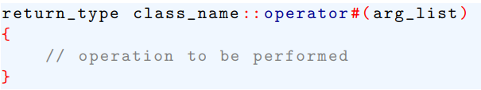
The basics of Operator Overloading
The general form of a member operator function is shown here:
The return type of an operator function is often the class for which it is defined.
However, an operator function is free to return any type.

Slide 3
The basics of Operator Overloading
The operator being overloaded is substituted for the #
For example, if the + is being overloaded, the function name would be operator +
The contents of arg-list vary depending upon how the operator function is implemented and the type of operator being overloaded.

Slide 4
The basics of Operator Overloading
There are two important restrictions to remember when you are overloading an operator.
First, the precedence of the operator cannot be changed.
Second, the number of operands that an operator takes cannot be altered.
For example, we cannot overload the / operator so that it takes only one operand.

Slide 5
The basics of Operator Overloading
Most C++ operators can be overloaded. The only operators that you cannot overload are: . :: .* ?

Slide 6
Overloading Binary Operators
When a member operator function overloads a binary operator, the function will have only one parameter.
This parameter will receive the object that is on the right side of the operator.
The object on the left side is the object that generates the call to the operator function and is passed implicitly by this.
It is important to understand that operator function can be written with many variations.

Slide 7
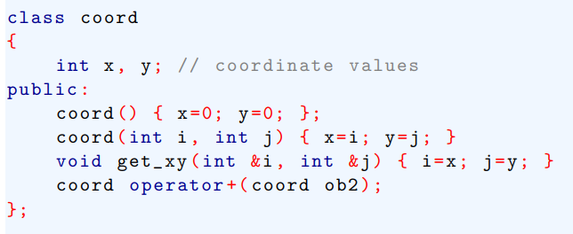
Overloading Binary Operators
Example – the following program overloads the + operator relative to the coord class. This class is used to maintain X, Y coordinates.

Slide 8
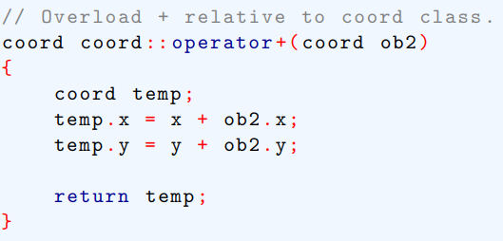
Overloading Binary Operators

Slide 9
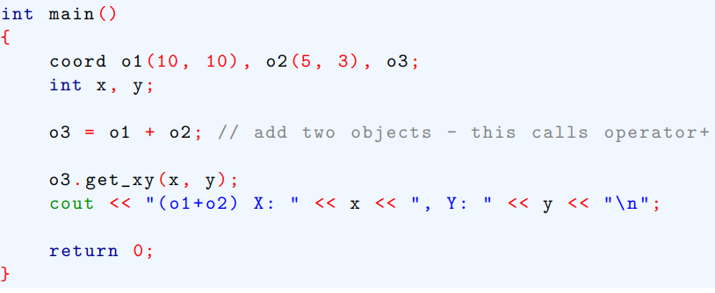

Overloading Binary Operators
The following statement is also valid

Slide 10
Overloading Binary Operators
The following statement is also valid

Slide 11
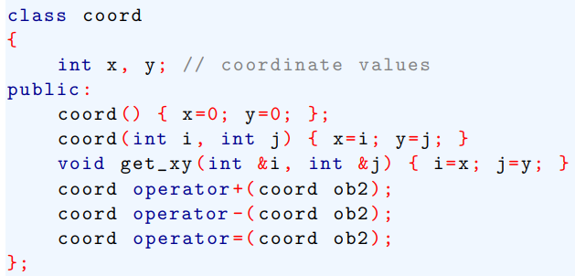
Overloading Binary Operators
The following version of the preceding program overloads the – and the = operators relative to the coord class.

Slide 12
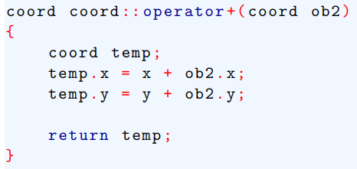
Overloading Binary Operators

Slide 13
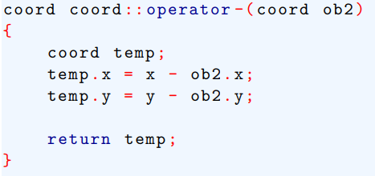
Overloading Binary Operators

Slide 14
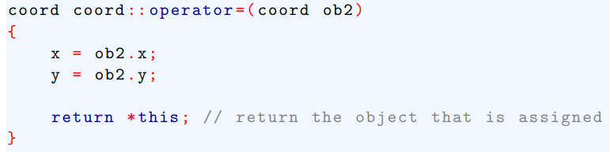
Overloading Binary Operators

Slide 15
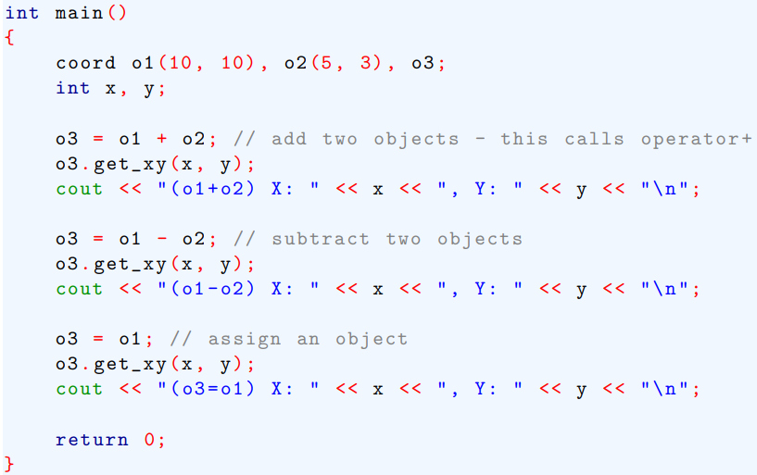
Overloading Binary Operators

Slide 16

Overloading Binary Operators
When the operator +( ) function was created, it did not matter which order the operands were in.
That is A+B is the same as B+A
However, subtraction operation is order dependent.
Therefore, to subtract the operand on the right from the operand on the left.
Because it is the left operand that generates the call to operator –( ), the subtraction must be in this order:

Slide 17
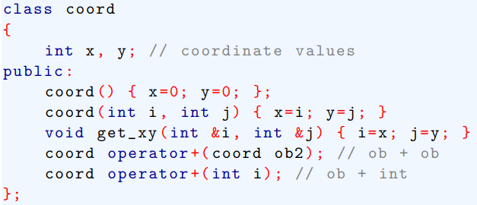
Overloading Binary Operators
It is possible to overload an operator relative to a class so that the operand on the right side is an object of a built-in type, such as an integer.

Slide 18
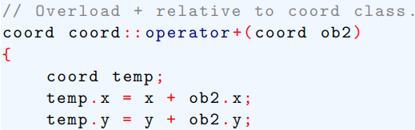

Overloading Binary Operators

Slide 19
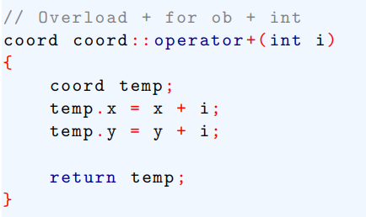
Overloading Binary Operators

Slide 20
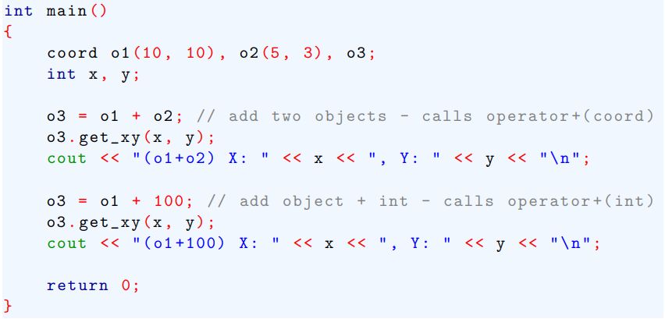
Overloading Binary Operators

Slide 21

Overloading Binary Operators
What happens when the compiler sees the following statement?
The overloaded operator + ( int i) function works only when the object is on the left.
Therefore, this statement generates compile-time error.

Slide 22
Overloading the Relational and Logical Operators
It is possible to overload the relational and logical operators.
They will return an integer that indicates either true or false.

Slide 23
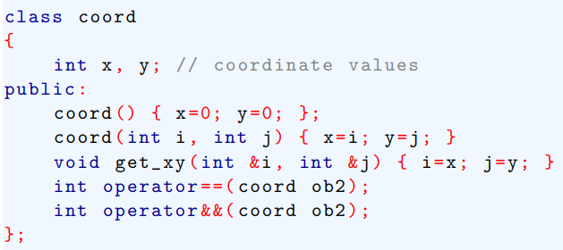
Overloading the Relational and Logical Operators
In the following program, the == and && operators are overloaded.

Slide 24
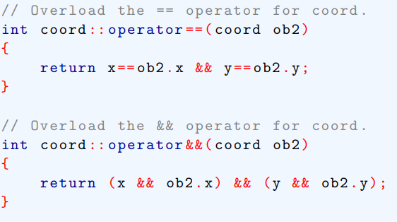
Overloading the Relational and Logical Operators

Slide 25
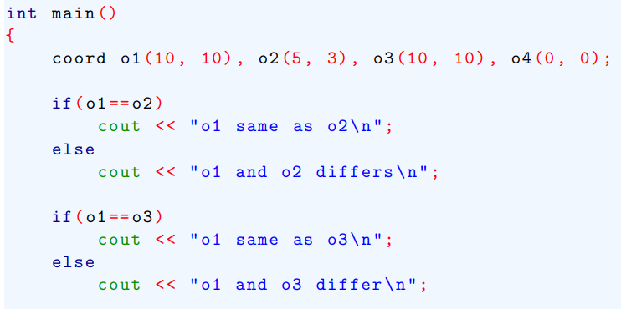
Overloading the Relational and Logical Operators

Slide 26
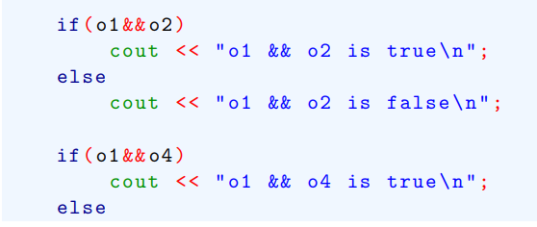
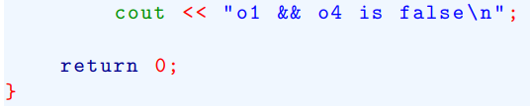
Overloading the Relational and Logical Operators

Slide 27
Overloading a Unary Operator
Overloading a unary operator is similar to overloading binary operator except that there is only one operand to deal with.
When we overload a unary operator using a member function, the function has no parameter.
Since there is only one operand, it is this operand that generates the call to the operator function.
There is no need for another parameter.

Slide 28
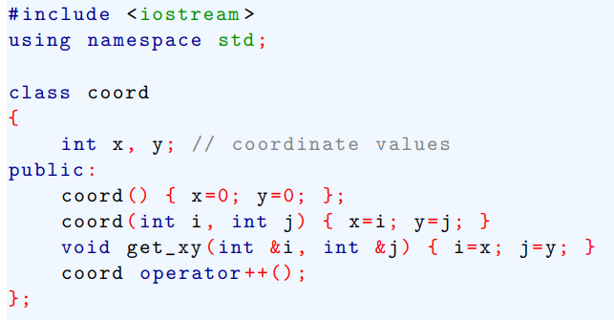
Overloading a Unary Operator
Example- the following program overloads the increment operator (++) relative to the coord class.

Slide 29
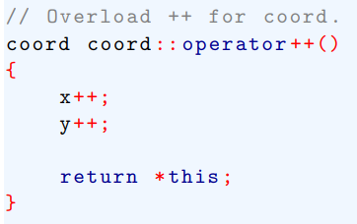
Overloading a Unary Operator

Slide 30
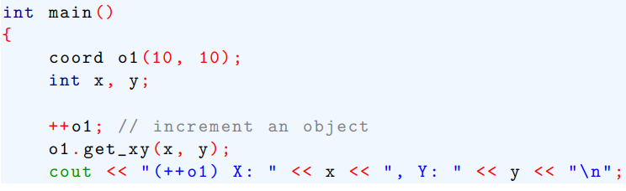

Overloading a Unary Operator

Slide 31

Overloading a Unary Operator
Assuming the preceding program, these two statements would have been identical
Modern specification for C++, create two version of the operator ++( ) functions.
First is shown in the preceding example.
The second is declared like this:

Slide 32
Overloading a Unary Operator
The second is declared like this:
In this case, notused will always be passed the value 0.

Slide 33
Using Friend Operator Functions
It is possible to overload an operator relative to a class by using a friend rather than a member function.
As we know, a friend function does not have a this pointer.
In this case of a binary operator, this means that a friend operator function is passed both operands explicitly.
For unary operator, the single operand is passed.

Slide 34
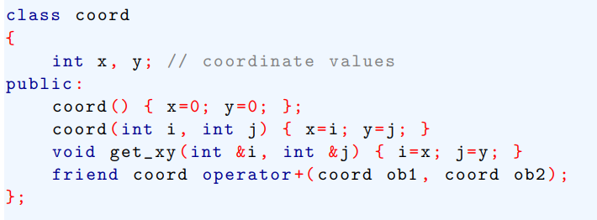
Using Friend Operator Functions
Here operator + ( ) is overloaded for the coord class using a friend function.

Slide 35
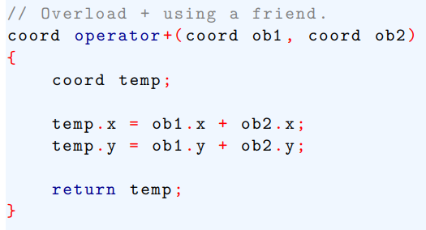
Using Friend Operator Functions

Slide 36
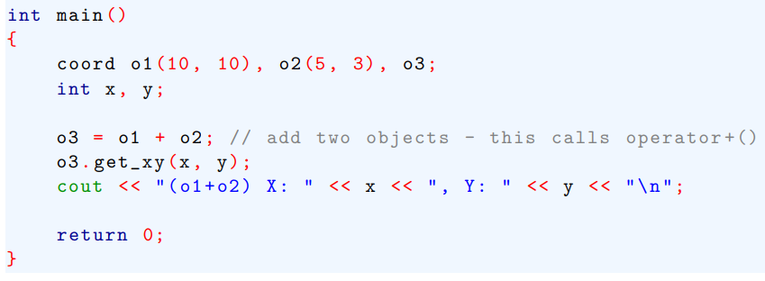
Using Friend Operator Functions

Slide 37

Using Friend Operator Functions
As We know, an overloaded member operator function,
The solution to this problem is to make the overloaded operator functions friends and define both possible situations.

Slide 38
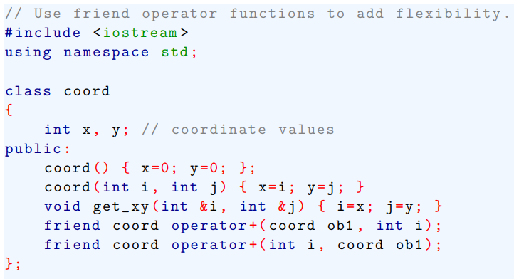
Using Friend Operator Functions

Slide 39
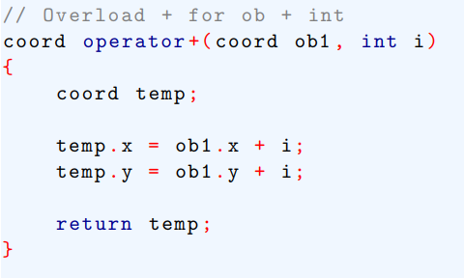
Using Friend Operator Functions

Slide 40
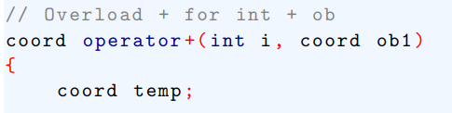
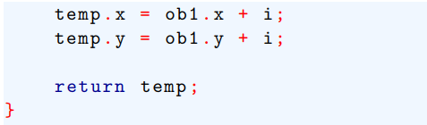
Using Friend Operator Functions

Slide 41
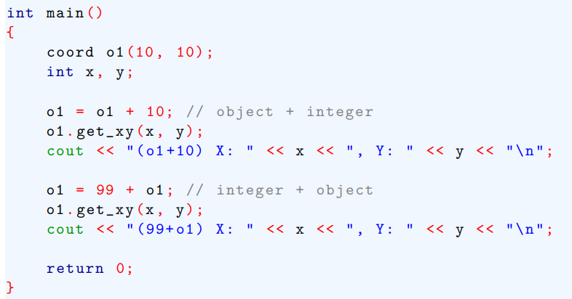
Using Friend Operator Functions

Slide 42
Using Friend Operator Functions
If we want to use a friend operator function to overload either the ++ or - - unary operator, we must pass the operand to the function as a reference parameter.

Slide 43
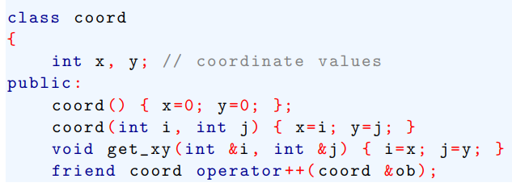
Using Friend Operator Functions

Slide 44
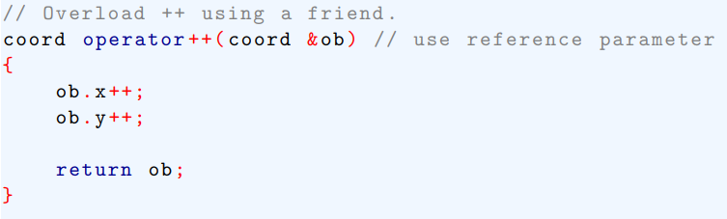
Using Friend Operator Functions

Slide 45
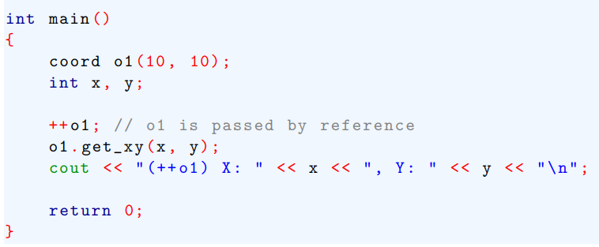
Using Friend Operator Functions

